Slide 1

AI in Finance
June 18, 2025
by Michael Garcia, Miguel Mora, Hashim Sayed Hoosini

Slide 2
Domain Overview & Importance
Finance includes banking, investing, insurance, and asset management.
It handles trillions of dollars daily across global financial markets.
Accuracy, speed, and security are essential for every financial transaction.
The industry faces rising fraud, increasing volatility, and persistent cyber threats.
It is a highly regulated and data-rich environment that is ideal for AI applications.
AI enhances decision-making, improves efficiency, and strengthens risk control.

Slide 3

AI Use Case Motivation
Financial institutions must process millions of transactions every second.
Traditional fraud detection systems struggle to keep up with modern cybercrime techniques.
AI enables continuous, real-time monitoring of transactions and detection of potential threats.
AI-powered systems reduce loan approval times from several days to just minutes.
For example, Mastercard's Decision Intelligence platform detects fraud within 50 milliseconds by analyzing patterns learned from historical data.
JP Morgan's COiN (Contract Intelligence) system analyzes 12,000 legal contracts in seconds, a task that would take 360,000 hours manually.

Slide 4






AI Techniques Used
Machine Learning (ML)
Natural Language Processing (NLP)
Learns from historical financial data to predict credit risk, defaults, and market trends.
Extracts insights from financial news, earnings calls, and filings to inform investment decisions.
Convolutional Neural Networks (CNNs)
Reinforcement Learning (RL)
Continuously refines algorithmic trading strategies through trial and error based on market feedback.
Interpret chart patterns, visual market data, and even handwriting on scanned documents.
Anomaly Detection
Deep Learning
Flags irregular transaction behavior for further investigation and fraud prevention.
Powers robo-advisors like Betterment to deliver personalized investment strategies through advanced neural networks.

Slide 5
Key Applications
Fraud Detection and Prevention: AI systems analyze transaction patterns in real time to flag suspicious activity.
Credit Scoring and Risk Assessment: AI can evaluate non-traditional data to assess creditworthiness.
Customer Service Chatbots: Virtual Assistants powered by AI handle routine customer inquires 24/7
Portfolio Management: AI tools assist wealth managers by analyzing market data and client profiles to optimize investment portfolios in real time.

Slide 6
Impacts and Benefits
Increased Efficiency: AI automates repetitive tasks such as data entry, compliance checks, and customer queries, freeing up human talent for more strategic work.
Enhanced Fraud Detection: Machine Learning models can detect anomalies in real time which would reduce fraud detection time by up to 90% compared to traditional methods.
Improved Risk Management: AI models assess credit and market risks more accurately by analyzing vast datasets.
Personalized Financial Services: AI helps deliver services that match individual customer needs and goals.

Slide 7



Challenge and Risk
Data privacy and security
Data privacy and security in finance means protecting sensitive customers information, like names , account number , and financial records. Since AI uses large amount this data to learn and make decision, strong cybersecurity is needed to keep it safe. Financial institution must get customer permission to use their data and provide transparent information and try to remove details when possible. If security is weak , trust is lost and banks risks legal and financial trouble.
Algorithmic Bias & Fairness
Artificial Intelligence transforming finance, but if the algorithms trained based on the biased training, it can bring serious legal and ethical challenges, like unclear accountability, discrimination, data privacy risk, or unfair decisions.
Fraud & Cybercrime
As banks use more AI , they face new risk of cyber-attack and Fuad, phishing scams, fake identity using deepfakes, AI generated fake apps and browser extensions.

Slide 8
Future Trends In Finance
Federated Learning for privacy
Enables training Ai models without sharing sensitive financial data, improving security and compliance.
Explainable AI (XAI)
Improves trust in AI systems by making decisions- making transparent and auditable for regulators and customers.
Generative AI for personalized Banking
Large language models (LLMs) like chat GPT-4 are being used for custom financial advice, fraud detection , and automated client interaction.
Real-Time AI for Risk Mangement
AI is used for immediate fraud detection, credit scoring, and volatility predication- making decisions faster and safer.
AI in ESG (Enviromental ,Social ,Governance ) Investing
AI tools analyze massive unstructured data source to evaluate companies on ESG performance.

Slide 9
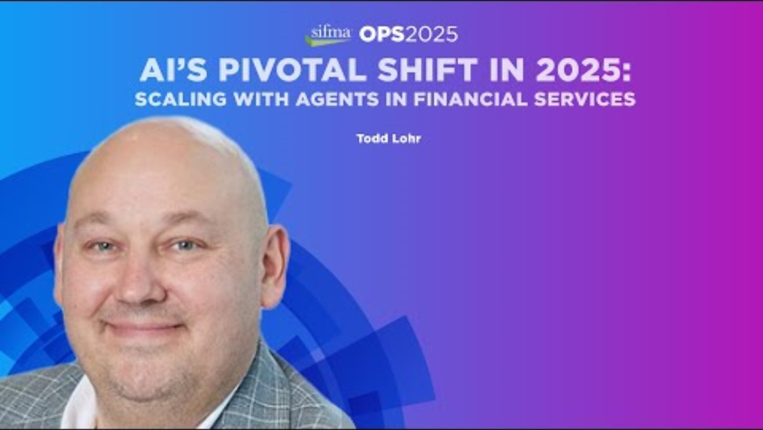
Interactive Slide / Demo

Slide 10
Conclusion
AI reshaping the Financial sector.
Enhance efficiency and accuracy.
Improve fraud detection and personalized banking.
Challenges like data privacy and, bias , and cyber-attack exist.
With responsible use of explainable AI and Federated Learning the future can be more secure and ethical.

Slide 11
References & Acknowledgments
Mastercard AI. (2023). https://www.mastercard.us/en-us/business/overview/safety-and-security/artificial-intelligence.html
JPMorgan COiN. (2021). https://www.jpmorgan.com/technology/artificial-intelligence
PayPal AI Fraud. (2022). https://newsroom.paypal-corp.com
BlackRock Aladdin. (2020). https://www.blackrock.com/aladdin
Betterment Robo-Advisors. (2023). https://www.betterment.com
Upstart AI Lending. (2022). https://www.upstart.com/research
What Is Artificial Intelligence in Finance? | IBM
“What Are the Challenges of AI in Financial Services.” Canon Business Services, business.canon.com.au/insights/challenges-of-ai-in-financial-services. Accessed 18 June 2025.
Jas Johal, et al. “Balancing Act: Managing AI Governance Risks in Financial Services.” Alvarez & Marsal | Management Consulting | Professional Services, 29 Oct. 2024, www.alvarezandmarsal.com/insights/balancing-act-managing-ai-governance-risks-financial-services.

